Slide 1
How much in retirement is enough
Manoj Abichandani
SMSF Specialist (UNSW)

Slide 2
House Keeping - Audio
If Computer sound is not audio able
Phone the number on your panel
Enter Access Code

Slide 3
House Keeping – Hand Out
Copy of this Presentation can be downloaded
From the Panel

Slide 4
House Keeping – Questions on this Presentation
If you have any Questions on this Presentation
Type in your questions in the panel
Speaker will answer all your questions
after the presentation

Slide 5
Disclaimer of Legal & Financial Advice – Educational Purpose Only
Statement
This paper represents the opinion of the author (s) and not necessarily those of Deed Dot Com Dot Au Pty Ltd. The contents are for general information only. They are not intended as professional advice - for that you should consult a Accountant or other suitably qualified professional. Deed Dot Com dot Au Pty Ltd expressly disclaims all liability for any loss or damage arising from reliance upon any information in this presentation.
Disclaimer
The information contained in this presentation is based on the understanding of the author has of the relevant Australian laws as at 27th December 2021. As these laws are subject to change you should refer to ATO’s website or talk to a professional adviser for the most up-to-date information. The information is for adviser use only and is not a substitute for investors seeking advice. While all care has been taken in the preparation of this document (using sources believed to be reliable and accurate), no person, including Deed Dot Com Dot Au Pty Ltd, accepts responsibility for any loss suffered by any person arising from reliance on this information. This update is not financial product advice and does not take into account any individual’s objectives, financial situation or needs. Any examples are for illustrative purposes only and actual risks and benefits will vary depending on each investor’s individual circumstances. You should form your own opinion and take your own legal, taxation and financial advice on the application of the information to your business and your clients.
Manoj Abichandani is NOT a financial planner or a Tax Agent and this presentation should not be construed as Tax or Financial advice

Slide 6
Agenda How much in retirement is enough
Save VS Spend Income – Which one?
Paying off the Home Loan – Good or Bad
Some assets grow and some give income - Land
When to stop passive income – when you have enough
Give to kids with a warm hand

Slide 7
Save VS Spend Income – Which one?

Slide 8
Today / Tomorrow
Accumulating
Retirement
Today
Tomorrow
AGE
Working for money
Working not for money

Slide 9
Today / Tomorrow
Accumulating
Retirement
Today
Tomorrow
AGE
Working : for money
Working : not for money

Slide 10
These people will delay your retirement
Tax man
Bank man
Employer

Slide 11
These people will delay your retirement
Tax man = pay less tax
Bank man = fool him
Employer = Get rid of him, if you can

Slide 12
How do you pay less Tax
Earn Less Taxable Income

Slide 13
Tax man = pay less tax
Tax man will tax you more if your income is more
Taxable income | Tax on this income
0 – $18,200 | Nil
$18,201 – $45,000 | 19 cents for each $1 over $18,200 $45,000 - $18,200 = $26,800 x 19% = $5,092
$45,001 – $120,000 | $5,092 plus 32.5 cents for each $1 over $45,000
$120,001 – $180,000 | $29,467 plus 37 cents for each $1 over $120,000
$180,001 and over | $51,667 plus 45 cents for each $1 over $180,000

Slide 14
Some Facts
If you earn more than $1 more than $45,000 – Tax man will come and take away 32.5% plus 2% Medicare Levy – more than 1/3rd of your income
Tax rate of companies is only 25%
If you have a company = you will pay less tax
(does not apply to employees – due to PSI rules)
Table: Progressive changes to the company tax rate
Income year | Aggregated turnover threshold | Tax rate for base rate entities under the threshold | Tax rate for all other companies
2020–21 | $50m | 26.0% | 30.0%
2021–22 and future years | $50m | 25.0% | 30.0%

Slide 15
But $45,000 Income is not enough
$45,000 – less tax $5,000 (exact figure $5,092) = $40,000 x 2 (H & W Working) = $80,000
Or Can you spend $1,538 per week
What about my home loan!

Slide 16
Do you own the home if you own only 20%
Address = Bella Vista
Land = 700 Sq Meters
House = 40 Squares
20% = 8 Squares or say 70 Sq Meter
You = say Formal Lounge
Bank = Rest of the house

Slide 17
Land Bella Vista
16/12/21 11 Pipersbrook Crs. 704.5Sq M $2.7M
15/11/21 35 Ernesta Pl 725Sq M $2.635M
17/10/20 32 Brighton Dr. 753 SqM $1.835M
04/09/19 26 Charlemont Tr 700 SqM $1.49M
14/08/15 3 Chamonix Pl 800 Sq M $1.3M
03/04/14 76 Edgewater Dr 750SqM $900K
08/08/12 16 Charlemont Tr 788 Sq M $592K
01/09/11 24 Brighton Dr. 763Sq M $585K

Slide 18
House Prices: Bella Vista
14/12/21 35 Bella Vista Dr. 788 SqM $2.35M
13/12/21 19 Prestige Ave 710 SqM $2.57M
31/10/21 10 Waddell Rd 722 SqM $3.22M
15/10/21 12 Waterfall Crs. 863 SqM $2.80M
13/09/21 12 Pipersbrook Crs 703SqM $2.84M

Slide 19
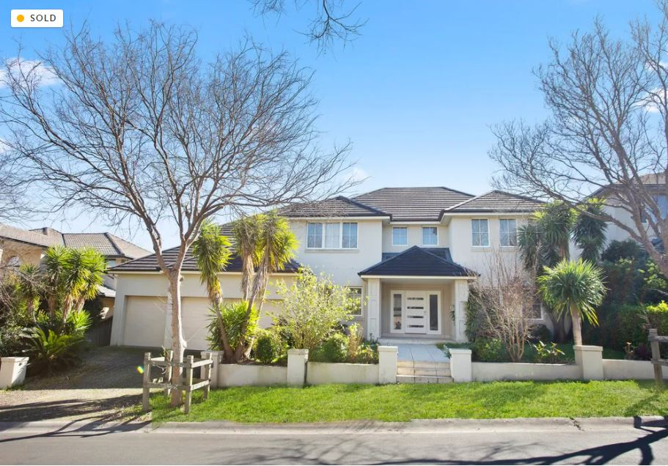
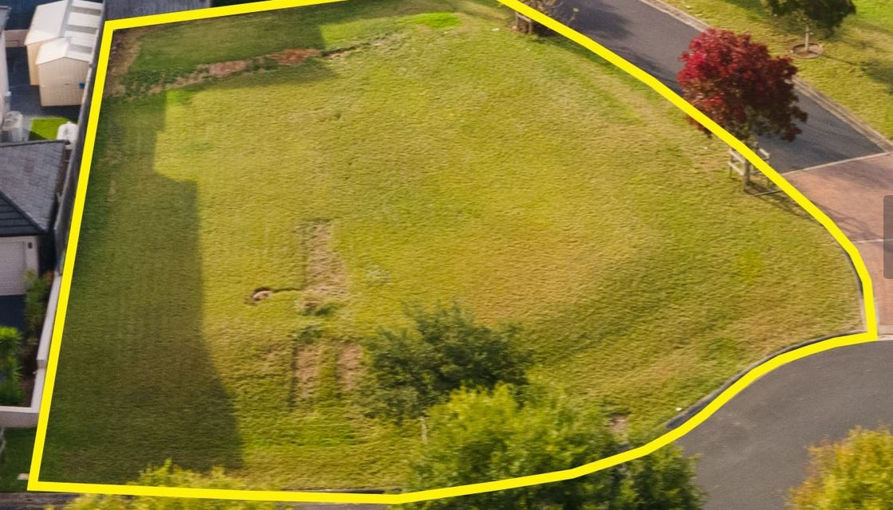
Is it better to Land Bank?
12 Pipersbrook Cres.
Sold $2.84M 13/09/21
Sold $2.25M 01/09/15
Sold $1.21M 12/03/06
11 Pipersbrook Cres.
Sold $2.7M 16/12/21
Sold $2.4M 01/7/21
Sold $685K 01/09/12

Slide 20
Negative Gearing
Rule of Thumb: House of $500,000 generates $500 rent per week = it takes 1,000 weeks or about 19 years to recover the cost
You have to borrow to build a house – Loan of $500,000 @3.29 Fixed Rate is $2,188 per month for a 30 year loan
After 19 years the house is not worth a lot as new building styles come
Renting a house is the worst investment decision
Many areas you can buy an old house at land value – the adage: worst house in the best street
A brand new house on land should be sold as soon as it is built and not rented out
A 0% return on Land (besides holding costs) is better than Negative return on a house
Rich people always land bank and never rent out

Slide 21
Some of the lessons which I have learnt
Residential Property:
Buying land is better than buying a house – it grows quicker
Rental return is very low
Property Depreciates – Land Appreciates
Almost always results in Negative Gearing due high amount of loan to build the house
If Value goes up by $200,000 per year – it is growing @$4,000 per week – there is no need for annual return (rent)
Commercial Property:
There can be multiple uses to commercial land
Beauty is in the eyes of the beholder – you see Dirty Tyre shop – I see Spanking KFC
Give rent-free period to get more rent for a better yield – higher yield results in better price
Tennant is responsible for all repairs

Slide 22
Bank man = fool him
(most of them are not smart
– they just follow the tick boxes)
What about my home loan!

Slide 23
Situation
Home Bella Vista
Value Today $2.5M
Purchased in 2020 for $2.3M (Banks Value)
Loan $1.2M (Sold a house before)
Equity Today $1.3M
Bank needs 20% of Valuation or $2.5M X 20% = $500K
Extra Equity $800K
--------
Total Equity $1.30M

Slide 24
How to fool the bank man
Don’t pay Principal and don’t pay Interest
Home Loan 1 Home Loan 2
$1.2M Extra Equity $800K
4 Year Fixed Principal + Interest
Loan Term 30 Years
Interest Rate 3.29%
Monthly Instalments $5,249
1 Year = $5,249 x 12 = $62,988
4 Years $62,988 X 4 = $251,952
10 Years $62,988 x 10 = $629K
Interest on 2nd Loan $116,822*
Total of Loan 2 after 10 Years
= $746,702 @ 3.29%
= $805,241 @5% after 4 Yr fixed period
*Refer to Spreadsheet

Slide 25
After 10 years of Home Loan 1 and Home Loan 2
Home Loan 1 $1,2M
Home Loan 2 $0.8M
Total Loans $2.0M
Value in 2021 $2.5M
Value in 2031
10% 20% 30% 40% 50% 100%
Value 2.75 3.00 3.25 3.50 3.75 5.00
Bank Equity (20%) 0.55 0.60 0.65 0.70 0.75 1.00
Extra Equity 200K 400K 600K 800K 1.0M 2.0M

Slide 26
Some of the lessons which I have learnt
There is no need to pay Principal or Interest to the bank
You should payback nothing to the bank
Most rich people have big loans
$1500 per week is enough for a family who has no home loans to pay
There is no need to have taxable income greater than $45,000
If you earn a salary package is $110,000 what should you do with the balance $65,000 after $45,000 taxable income – Since we do not need it for today – put it in tomorrows pocket = Superannuation

Slide 27
What do the bank and Govt. Wants us to do?
https://moneysmart.gov.au/home-loans/pay-off-your-mortgage-faster
Avoid an interest-only loan
Paying both the principal and the interest is the best way to get your mortgage paid off faster. Most home loans are principal and interest loans. This means repayments reduce the principal (amount borrowed) and cover the interest for the period.
With an interest-only loan, you only pay the interest on the amount you've borrowed. These loans are usually for a set period (for example, five years).
Your principal does not reduce during the interest-only period. This means your debt isn't going down and you'll pay more interest.
Make higher repayments
Another way to get ahead on your mortgage is to make repayments as if you had a loan with a higher rate of interest. The extra money will help to pay off your mortgage sooner.
If you switch to a loan with a lower interest rate, keep making the same repayments you had at the higher rate.
If interest rates drop, keep repaying your mortgage at the higher rate.
Make extra payments
Extra repayments on your mortgage can cut your loan by years. Putting your tax refund or bonus into your mortgage could save you thousands in interest.
On a typical 25-year principal and interest mortgage, most of your payments during the first five to eight years go towards paying off interest. So anything extra you put in during that time will reduce the amount of interest you pay and shorten the life of your loan.
Ask your lender if there's a fee for making extra repayments.
https://www.nab.com.au/personal/life-moments/home-property/pay-off-home-loan/should-i-pay-off
Reminder – I am not a financial planner
I am just showing you how I do things for myself and NOT suggesting
that you should follow me

Slide 28
How much deductible amount we can we put into Super
Compulsory Employer should put 10% of Wages
Maximum Concessional cap amount (This is what your accountant will tell you) $27,500
After Tax (non-concessional) every year cap amount $110,000
Maximum you can put in Super every year is $137,500
(As any amount above the concessional cap amount is counted towards the non-concessional cap amount)

Slide 29
If $110,000 is salary Package
How to maximise super with $110,000 Income
Income |  | 110000
Wages | 45,000 |  | Super Contribution | 56,400
Tax | 5,092 |  | Tax in Super | 8,460
 |  |  | In Super after Tax | $47,940
Extra to pay Tax | 8,600 |  | Concessional Contribution | 27,500
Tax @34.5% | 2,967
 |  |  | Extra Concessional Contribution | 28,900
Cash To pay Excess Contribution Tax Amount | 5,633 |  | Added to your Income
 |  |  | Extra Tax to be paid | 34.5
Total Taxable Income | 53,600 |  | Less Already Paid in Super | 15
 |  |  | Extra Tax to be paid outside Super | 19.5
 |  |  | Tax to be paid for extra
 |  |  | Concessional Contribution | 5635.5
How much to put in Super is Financial Advice
Warning: I am not a financial Planner

Slide 30
How does super grow in the fund
Amount of Contribution
Rate of Return
How long has the money been in Super
The fees which is being charged to the fund
(Average MER is about 1.4% - Industry Fund 0.65%
- a $1,000,000 pays $6,500 in an Industry Fund)

Slide 31
The 10 top super funds in APRA’s performance test
https://www.afr.com/policy/tax-and-super/the-10-top-performing-super-funds-in-apra-s-performance-test-20211217-p59ie9
Fund* | Product | Test score | 7-year net investment return | Fund type
Unisuper | Balanced | 1.5 | 9.22% | Industry
Australian Ethical Retail Superannuation Fund | Balanced (accumulation) | 1.3 | 9.00% | Retail
AustralianSuper | MySuper | 1.2 | 9.65% | Industry
QSuper | Lifetime | 1.2 | 3.84-9.48% | Public sector
Cbus | MySuper | 1.1 | 9.34% | Industry
Hostplus | Balanced | 0.9 | 9.50% | Industry
Statewide | MySuper | 0.8 | 8.93% | Industry
First Super | MySuper | 0.8 | 8.39% | Industry
Care Super | CareSuper | 0.7 | 8.68% | Industry
Aware Super | MySuper Lifecycle | 0.7 | 6.86-8.66% | Public sector

Slide 32
How does super grow in the fund - Amount of Contribution
Minimum 10% Employer Contribution - $10,000 return 2% after fees
Income
Contribution
$ Value
Age
50
$280K
55
$350K
60
$425K
65
$508K
70
$597K
25
30
$54K
35
$104K
45
$216K

Slide 33
How does super grow in the fund - Amount of Contribution
Minimum 10% Employer Contribution - $10,000 return 6% after fees
Income
Contribution
$ Value
Age
50
$467K
55
$649K
60
$882K
65
$1.18M
70
$1.56M
25
30
$61K
35
$128K
45
$325K

Slide 34
How does super grow in the fund - Amount of Contribution
Max Concessional Contribution - $27,500 return 6% after fees
Income
Contribution
$ Value
Age
50
$1.24M
55
$1.74K
60
$2.42M
65
$3.24M
70
$4.32M
25
30
$168K
35
$353K
45
$895K

Slide 35
How does super grow in the fund - Amount of Contribution
Recommended Contribution - $56,400- return 6% after fees
Income
Contribution
$ Value
Age
30
$346K
35
$725K
45
$1.8M
50
$2.6M
55
$3.6M
60
$4.9M
65
$6.6M
70
$8.8M
25

Slide 36
How does super grow in the fund - Amount of Contribution
Recommended Contribution - $56,400- at age 50 return 6% after fees
Income
Contribution
$ Value
Age
30
$100K
35
$125K
45
$150K
50
$200K
55
$616K
60
$1.07M
65
$1.65M
70
$2.4M
25

Slide 37
How does super grow in the fund - Amount of Contribution
Recommended Contribution - $56,400- at age 50 return 10% after fees
Income
Contribution
$ Value
Age
30
$100K
35
$125K
45
$150K
50
$200K
55
$718K
60
$1.39M
65
$2.4M
70
$3.9M
25

Slide 38
SMSF Statistical Report – June 21
Table 8.1: Proportion of funds, by asset range of fund
Asset Ranges | 2019–20 | 2018–19 | 2017–18 | 2016–17 | 2015–16
$0 to $50,000 | 4.9% | 5.9% | 5.9% | 6.1% | 6.3%
>$50,000 to $100,000 | 2.7% | 3.1% | 3.4% | 3.8% | 4.3%
>$100,000 to $200,000 | 6.6% | 7.0% | 7.8% | 8.5% | 9.3%
>$200,000 to $500,000 | 22.3% | 22.1% | 23.0% | 23.5% | 24.4%
>$500,000 to $1m | 25.8% | 24.8% | 24.5% | 24.2% | 24.1%
>$1m to $2m | 20.7% | 20.1% | 19.5% | 19.0% | 18.1%
>$2m to $5m | 13.4% | 13.2% | 12.5% | 11.9% | 10.9%
>$5m to $10m | 2.8% | 2.9% | 2.6% | 2.5% | 2.2%
>$10m to $20m | 0.7% | 0.7% | 0.7% | 0.6% | 0.4%
>$20m to $50m | 0.1% | 0.1% | 0.1% | 0.1% | 0.1%
>$50m | <0.1% | <0.1% | <0.1% | <0.1% | <0.1%
Total | 100% | 100% | 100% | 100% | 100%
Approx 600,000 funds of which 3.6% or 21,600 funds with more than $5M

Slide 39
ATO knows we are there….
Medium and emerging private groups
The medium and emerging private groups include:
private groups linked to an Australian resident individual who, together with their associates, control wealth between $5 million and $50 million
Australian businesses with annual turnover of more than $10 million that are not public or foreign-owned and not linked to a high wealth private group.
Medium and emerging private groups represent the majority of total private groups. We use enhanced data and analytics to understand the operating environment of these groups, identify and address tax risks and design tailored approaches to mitigate those risks.
https://www.ato.gov.au/Business/Privately-owned-and-wealthy-groups/What-you-should-know/Tax-performance-programs-for-private-groups/#Highwealthprivategroups

Slide 40
When do you pay the home loan
Tax in Super is 15%
Individual Tax Rate 34.5% between $45,000 to $120,000
Cost of paying $1,000 back to bank
Outside of Super From Super (after Age 60)
1000 x 100/65.5 1000 x 100/85
$1,526.71 $1,176.47
52.67% 17.64%
To Pay $3,000,000 back to the bank
$4,580,152 $3,529,411

Slide 41
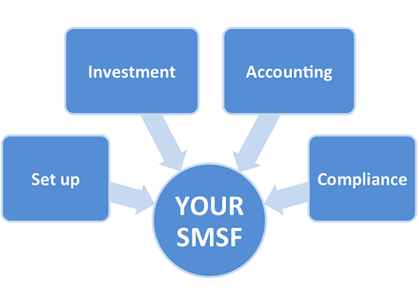
Set up of SMSF
Not for Everyone
Can be cheaper to run
You have investment responsibilities
You have to good with paperwork – Compliance
Must hire a specialist SMSF Accountant
Can cost between $2000 to $4000 per year to run
Must have at least $200,000 (APRA + ASIC + ATO) before you consider starting one
You can buy anything – shares / property / Land
You cannot do many things – loan to members / relatives / cannot live in the house owned by SMSF – but can rent commercial property

Slide 42
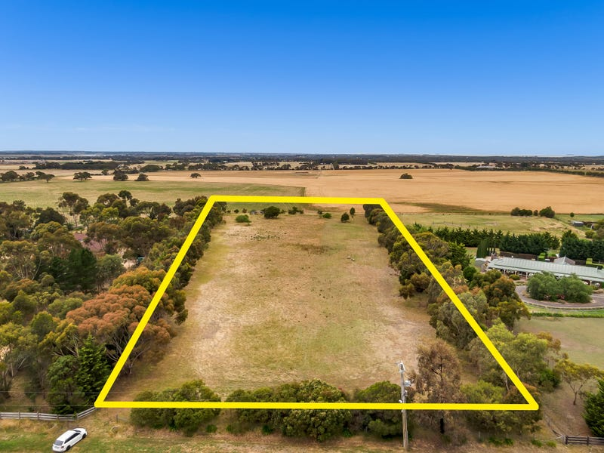
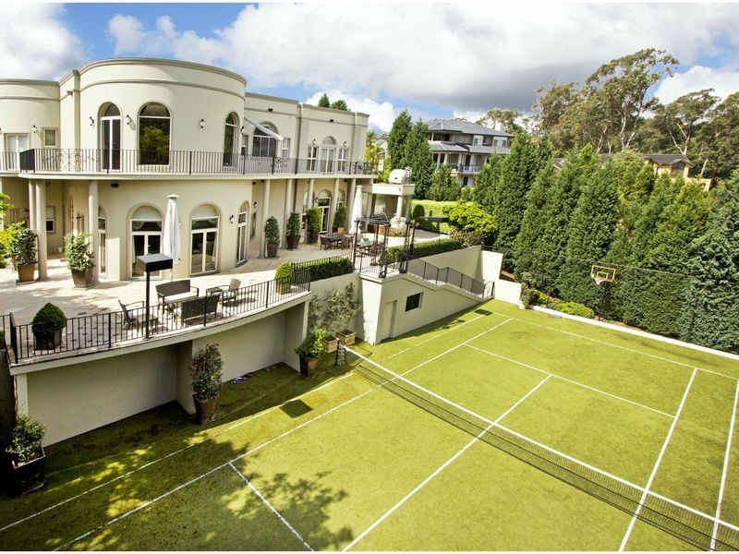
How do you get 10% or more return in SMSF
Land for Sale
Growth Asset
Trustees
Security
Own Home

Slide 43
How do you fund these purchases – PCG 2016/5
Land for Sale
Growth Asset
70% Loan
30% Deposit
Interest
Trustees
Interest
contribution
Employer
Security

Slide 44
Some of the Lessons which I have learnt
Start contribution to super early in age
Aim for a better return – if possible 10%
Do not pay anything to the bank
Reduce cost of managing super – SMSF
Pay off the Home Loan when 60 from SMSF when retired
Growth Asset to be purchased Only in SMSF
No Negative Gearing
All Assets only in SMSF – Only own home outside of Super
Accumulate wealth in Super

Slide 45
How much in Super is enough
The lifestyle you want
Think about how you plan to spend your money in retirement. If you own your own home, a rule of thumb is that you'll need two-thirds (67%) of your pre-retirement income to maintain the same standard of living in retirement.
The Association of Superannuation Funds of Australia (ASFA) provides an industry retirement standard. This estimates how much money you'll need, depending on your lifestyle.
https://moneysmart.gov.au/grow-your-super/how-much-super-you-need
Source: ASFA, June quarter 2021
ASFA Retirement Standard | Comfortable lifestyle | Modest lifestyle
Single | $44,818 a year $859 a week | $28,514 a year $546 a week
Couple | $63,352 a year $1,214 a week | $41,170 a year $789 a week

Slide 46
How much in Super is enough
In my opinion 200% or $3,000 per week or $150,000
Capital for 5% return or times 20
$150,000 (Fruit) x 20 = $3,000,000 (Tree)
Or say up to $1.7M each which is Transfer Balance Cap – the maximum which you are allowed to earn without paying any tax in Super
Total Super required is $3,400,000 plus $3,000,000 to pay off the home loan

Slide 47
What happens to super when you die (Tree)
Goes to spouse – reversionary pension
When 2nd spouse dies goes to dependents if any or to adult children
You must withdraw from super before 2nd spouse is ready to die – or adult kids will pay 15% + 2% Medicare Levy on Concessional Contribution and income of the fund
Give it to the kids so that they can build their own super

Slide 48
Is superannuation controlled by a will - No
Section 302-195 of Income Tax Act tells us who can be paid a death benefit
Parents and siblings can get paid via an estate
Only tax dependents (spouse or kids under 18 etc )can get tax free death benefits
Adult children will pay tax when they receive super death benefits
Binding death benefit nomination is given by member to the Trustee of the fund > Legal Personal Representative > Trustee of estate can get money from super to be distributed via a will
Testamentary Trust can be set up > date of death of the member

Slide 49
When one of two spouses die
In retirement - most likely some super will come out of the super system
When the 2nd spouse dies = all super comes out
How this super is taxed is the key to the whole game going forward

Slide 50
How much super can we have
There is no limit on how much super we can have
Non- Concessional Contributions are allowed up to your super reaches $1.7M
$1.7M + downsizer Contributions
Small Business Capital Gains tax Contributions
Growth in super due to income

Slide 51
How much can we have in tax free income
$1.7M is only a test point to start a pension – all growth after that is also tax free
If your income is more than your drawdown – Balance will increase
Age | 2013–14 to 2018–19 income years (inclusive) | 2019–20 to 2021–22 income years (inclusive)
Under 65 | 4.0% | 2%
65–74 | 5.0% | 2.5%
75–79 | 6.0% | 3%
80–84 | 7.0% | 3.5%
85–89 | 9.0% | 4.5%
90–94 | 11.0% | 5.5%
95 or more | 14.0% | 7%

Slide 52
What do we do
Sell SMSF Trust Deeds
SMSF Borrowing Documents
SMSF School.com.au = Coming Soon
Justsign.com.au – Online Digital Signature Tool

Slide 53
For further Enquires
please visit our websites:
www.trustdeed.com.au
www.onlinesmsfaudit.com.au
www.justsign.com.au
and chat with our agent.
Alternatively, you - contact us 0296844199 or
Email us at
sales@trustdeed.com.au
sales@onlinesmsfaudit.com.au
sales@justsign.com.au

